Slide 1
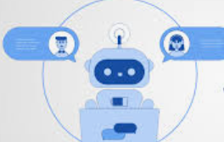
Chat AssiStant
MINI PROJECT
~ Narsini Shravani (1602-20-737-039)
~ Singari Tejaswi (1602-20-737-055)
~ Karthik Ramavath(1602-20-737-018)

Slide 2
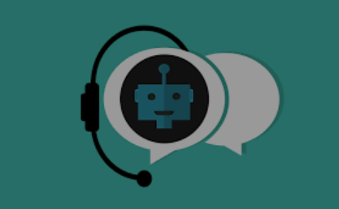
ABSTRACT
Chat assistant is a computer program which stimulates a conversation between a user and a computer.
In this project we are using tkinter, os and re libraries and modules for building our chat assistant. It is a python library which has a gui applications and also splitting ability.
Chat assistants work by analyzing the user’s request and delivers the appropriate response.
Main importance of chat assistant is it is integrated with various websites so that if customers have any queries they can first chat with chat assistant like they are talking to a real person.

Slide 3
APPLICATIONS AND FEATURES:
Economically offer 24/7 Service
Improve Customer Satisfaction
Personalized conversation
Accessibility
Reduce Costs
Reduce customer waiting time.

Slide 4
SIMILAR APPLICATIONS:
Banking, finance and fintech
Google Assistant
Online shopping(amazon, flipkart)
Healthcare
Appointment booking

Slide 5
FUTURE SCOPE:
Chat assistants and Chatbots are becoming more conversational to communicate effectively.
The future scope of chat assistants could include many benefits for enterprises.
Chatbots are fully functioning, semi-autonomous systems that can assist customer service experiences and response time.
The future of chat assistants is that businesses will automate simple payments and allow users to pay directly over live chat or facebook messenger apps.

Slide 6


